Slide 1
Is Family Medicine Right for Me?
9 Signs You Might be a Family Physician

Slide 2
Family Medicine.
Family medicine is the most diverse, dynamic, and in-demand medical specialty with countless ways to personalize a career around your unique values, needs and interests.
Here are 9 reasons family medicine might just be the best choice for you.
Family medicine might be your perfect match if you want to…

Slide 3
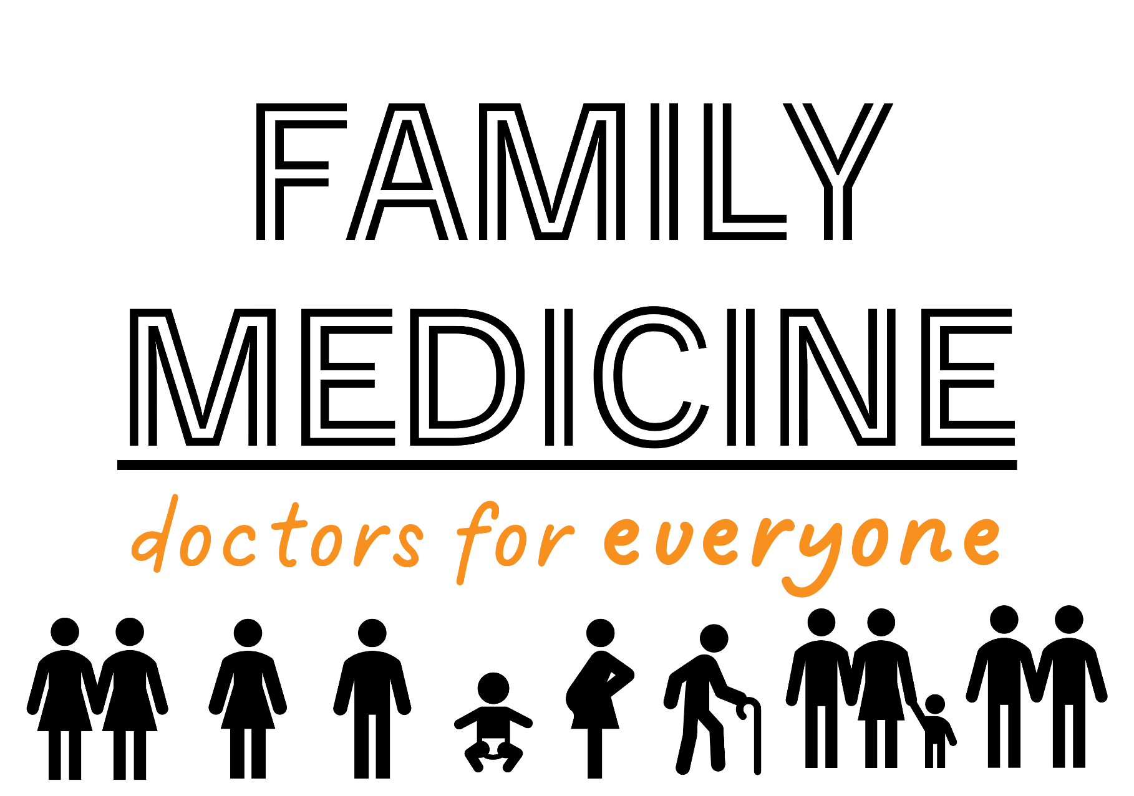
1…Provide Comprehensive Care to Patients You Know Well
Family physicians care for patients from birth through their wisdom years. You’ll learn to specialize in the whole person, not just a few diseases or organs, so you can build the deep, long-term doctor-patient relationships that are the foundation of holistic care.

Slide 4


2…Build a Practice That Reflects Who You Are
Family medicine opens doors to work in private practice, community health centers, rural clinics, academic institutions and more. You can choose to focus on sports medicine, maternity care, wilderness medicine or many other types of health care.

Slide 5



3…Deliver Health Care, Not Sick Care
“I love being able to embed myself in a community and in a family and support them through the most vulnerable spaces and times in their lives, and watch them grow, evolve and thrive.”
- Keyona Oni, M.D., B.F.M.O., I.B.C.L., FAAF
Family physicians help patients live their healthiest lives by delivering preventive care based on healthy behaviors and disease prevention. You’ll walk alongside your patients and communities throughout their health care journeys, helping them avoid the burdens of chronic diseases and rising health care costs.

Slide 6
4…Enjoy a Stable Career
%
Family physicians are in high demand as the country gets older and more focused on primary care. You can expect job stability, career flexibility and growing salaries with signing bonuses and loan repayment.
Did you know that in 2022 the average full-time family physician earned a total of $274,359*?
8%
Pathology
6%
Family medicine
5%
Anesthesiology, Psychiatry
4%
OBGYN
3%
Internal medicine, Radiology
2%
Gastroenterology
1%
Oncology
Specialties that gained or lost ground in pay in 2023
Source: Weatherby Healthcare; Physician salary report 2024: Increased earnings, but at slowing rates, July 2, 2024, accessed January 27, 2025
*Source: AAFP Career Benchmark Dashboard

Slide 7
5…Build a Balanced Life
Family physicians have more control over when and where they practice than many other specialists. You can build a career that gives you the time you want for hobbies, family and everything else that adds up to a well-rounded, fulfilling life.
79% of AAFP members reported being satisfied or very satisfied with their careers.
(2021)
Use your skills: broad scope of practice is associated with lower levels of burnout.
Family physicians have long-term career flexibility because of training scope and high recruitment demand.
Practice model plays a role in well-being. In primary care there are many clinic styles to choose from.

Slide 8
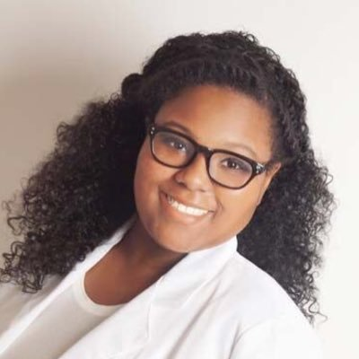
6…Do Something About Social Determinants of Health
Family medicine recognizes the impact of social factors, such as income, education, and access to resources, on health outcomes. You can advocate for equitable access to care for and address disparities within your community.
I make a difference for people and their families every day. They let me know when they find barriers so that I can help them.
Not every profession gets an opportunity to connect like this!
-Christen Johnson, MD, MPH

Slide 9

7…Be a Lifelong Learner
The wide variety of medical conditions family physicians handle fuels continuous learning, growth and professional development. You can look forward to being energized by treating patients’ complex needs in the context of their families and communities.

Slide 10

8…Gain a Supportive Community
You’ll find a network of professional support and encouragement in family medicine.
Start by claiming your free AAFP membership for medical students,
Then come to FUTURE (formerly known as National Conference) each summer to meet other students, residents and top residency programs.

Slide 11
9…Help Others and Fill Your Cup
Family physicians share story after story of filling their own cups by helping patients — advocating for them and understanding their individual needs. You’ll get to see your patients thrive and be a part of their story for many, many years.
#FamMed

Slide 12
Family Medicine.
It’s a human connection that’s not easily found in healthcare. And it’s one that patients are looking for - just as much as you.

Slide 13
Thank you!

